Slide 1
ENIGMA Integrative Analysis Update
2025/01/10

Slide 2
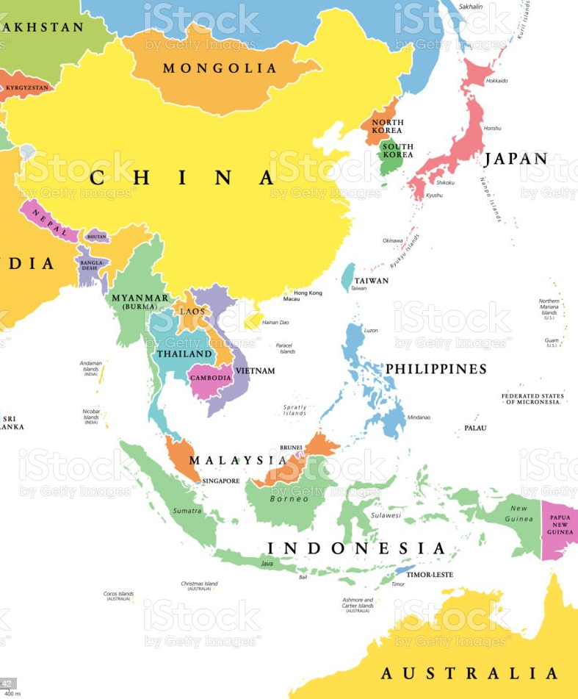
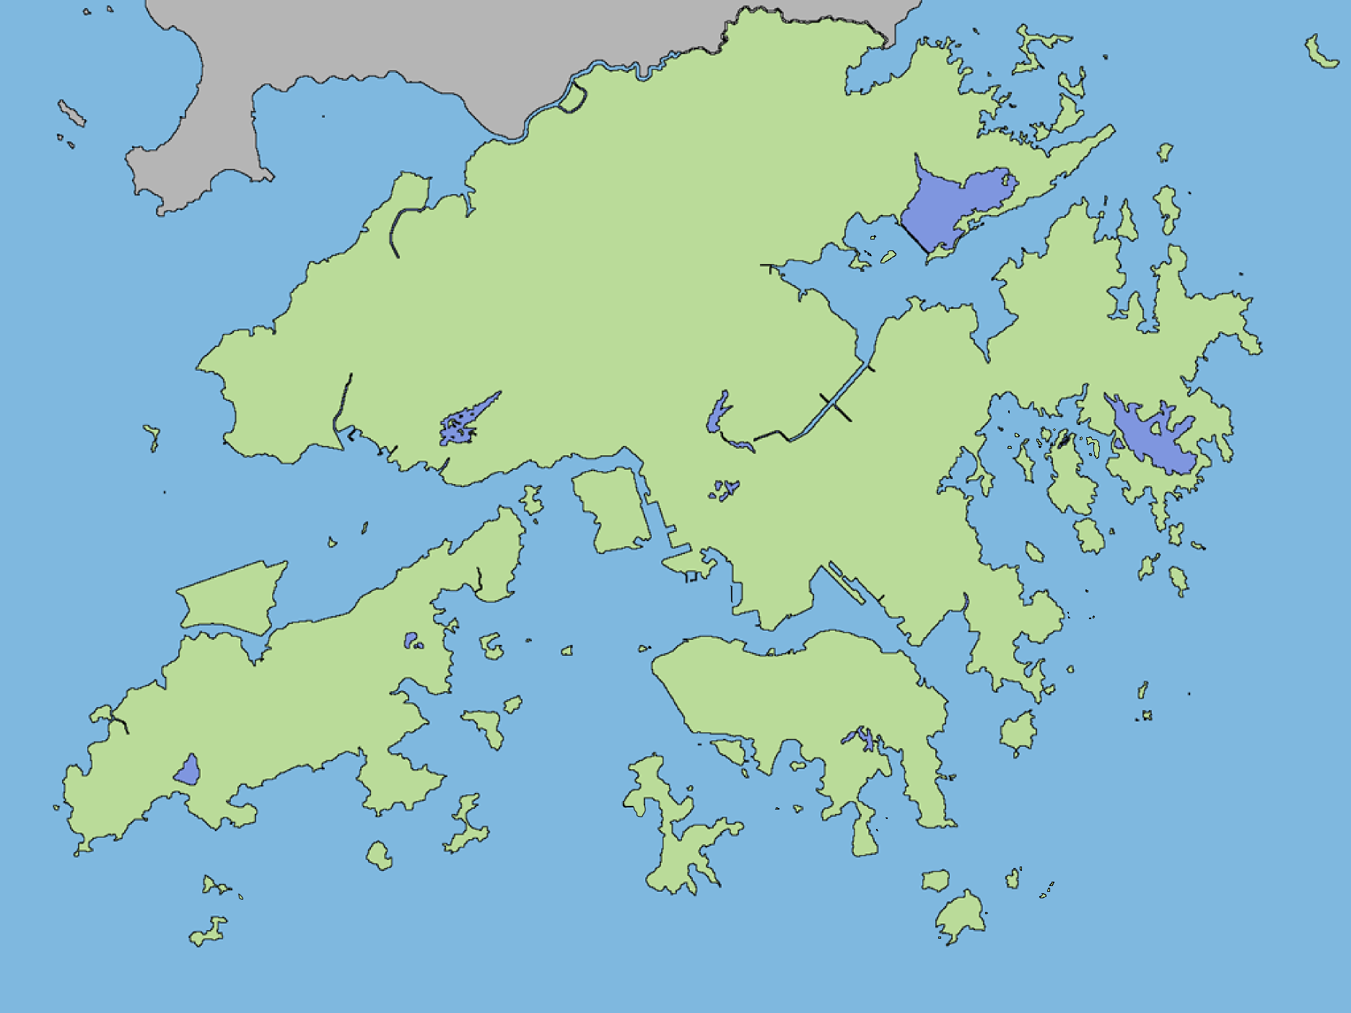
605 subjects from three regions
Subjects | Sample size (n)
Crohn’s disease | 251
Controls | 354
Kunming, China (MC)
(Asian, Rural)
Hong Kong (HK)
(Asian, Urban)
Australia (AUS)
(Caucasian, Urban)
CDAI
< 150 remission 【inactive】
150 to 219, mildly active disease; 【active】
220 to 450, moderately active disease; 【active】
> 450, severe disease【active】

Slide 3










Graphical Summary of ENIGMA Research Cohort
Species Abundance
(n =605 )
Anthropometrics
Pathway Expression
Diet
Metagenomic sequencing
(n = 479)
Gene Transcription
Early life exposures
(n = 615)
CD subjects
Controls
Medication
Biopsy 16s
rRNA sequencing
Australia
Hong Kong
Kunming
(n = 266)
Food additives
Questionnaires

Slide 4
Aims
To illuminate the signatures of microbiome, microbial genes and functional pathways in CD patients and controls cross populations
To uncover the clinical information, environmental factors and bacterial features that may correlated with disease activity in CD

Slide 5
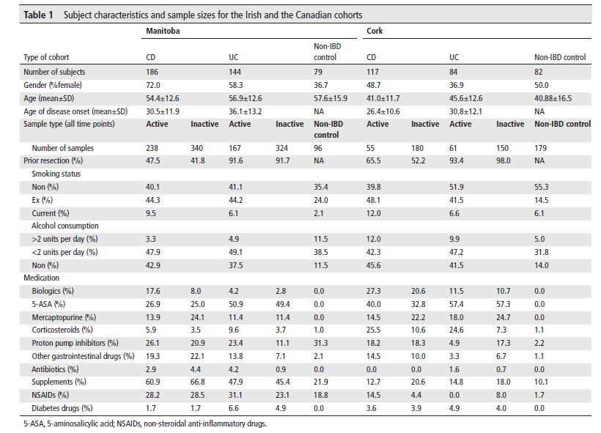
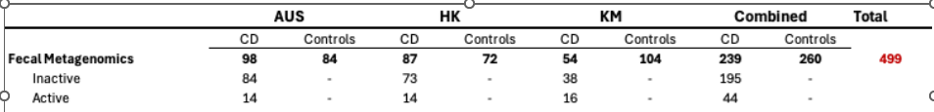
Notes:
Ranking microbiome variance in inflammatory bowel disease: a large longitudinal intercontinental study

Slide 6
CDAI VS Fecal calprotectin
Spearman correlation
HK
AUS
HK+AUS
KM(补充)

Slide 7
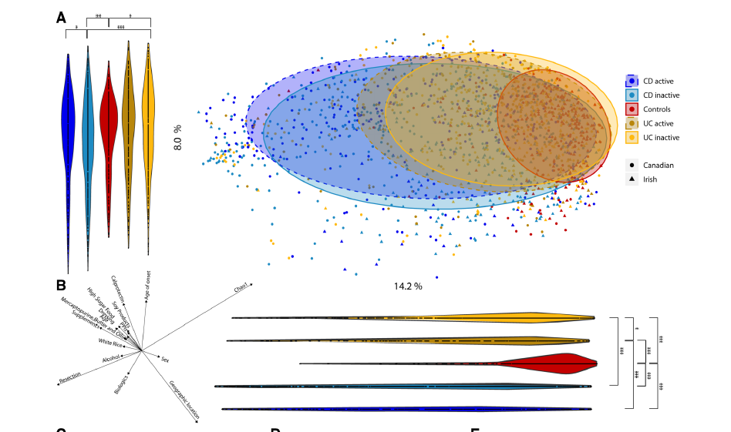
Gut microbiome composition （PCOA）
Notes:
Ranking microbiome variance in inflammatory bowel disease: a large longitudinal intercontinental study

Slide 8
Shannon Diversity and Observed Species Number cross AUS, HK, and KM
Shannon Index
Observed Species
CD Controls

Slide 9
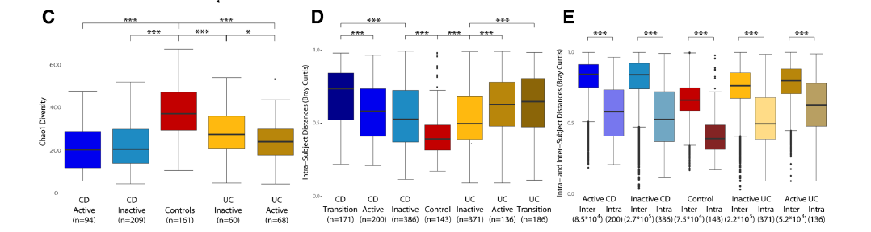
Notes:
Ranking microbiome variance in inflammatory bowel disease: a large longitudinal intercontinental study

Slide 10
Microbiome Analysis Workflow
Relative Abundance of Bacterial Species
Venn Diagram
Venn Diagram
Data Filtering
Venn Diagram
Bar Plots
MaAsLin2
Venn Diagram
Heatmap
CD-enriched and CD-depleted Species

Slide 11
Venn Diagram for Bacterial Species
Unfiltered
Filtered (qvalue<0. 25)

Slide 12
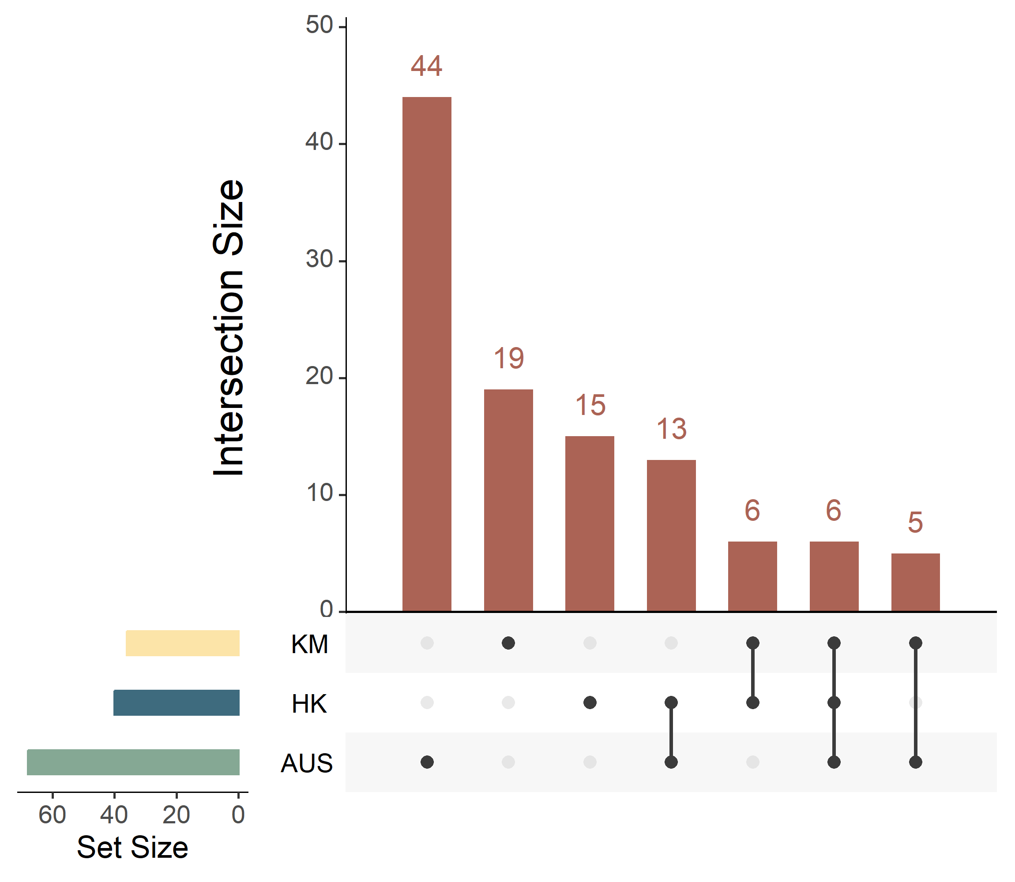
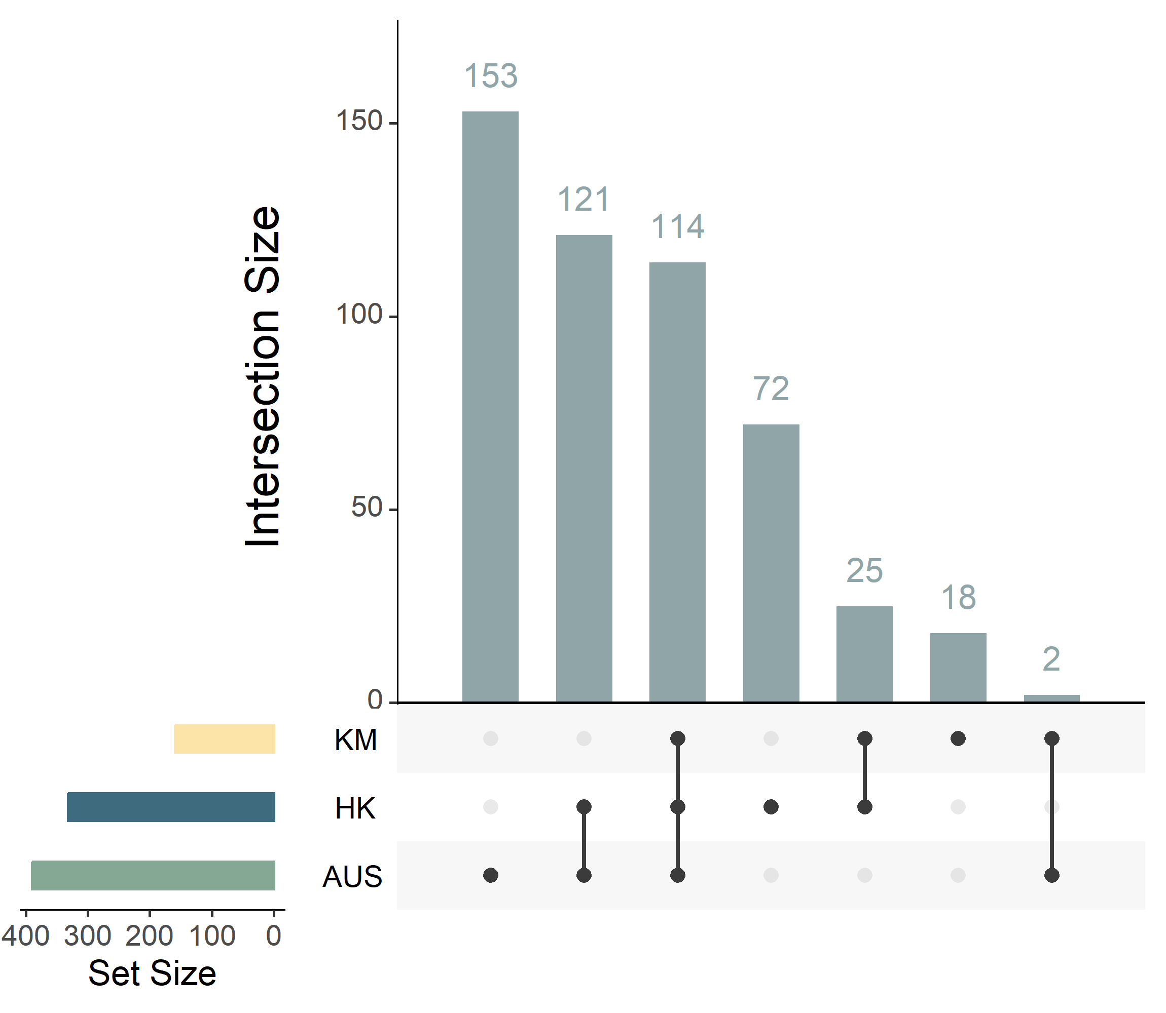
Comparison of CD-enriched and CD-depleted species among AUS, HK, and KM
CD-enriched bacteria
CD-depleted bacteria
36
159
40
332
68
390

Slide 13
CD-enriched species
(n=6)
Escherichia coli
Erysipelatoclostridium ramosum
Enterococcus faecalis
Enterococcus faecium
Fusobacterium nucleatum
Limosilactobacillus fermentum
CD-depleted species
(n=114)
Scaled(Log10(Matrix))

Slide 14
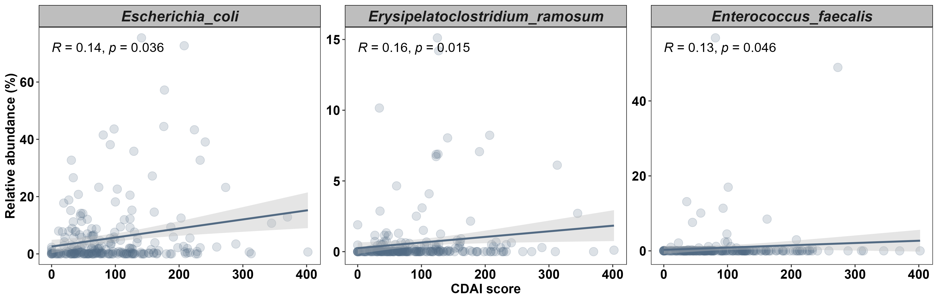
Three Species Consistently Correlated with Disease Activity (CDAI)

Slide 15
Functional Pathways Analysis Workflow
Relative Abundance of Pathways
Venn Diagram
Venn Diagram
Data Filtering
Venn Diagram
Bar Plots
MaAsLin2
Venn Diagram
Heatmap
CD-enriched and CD-depleted Pathways

Slide 16
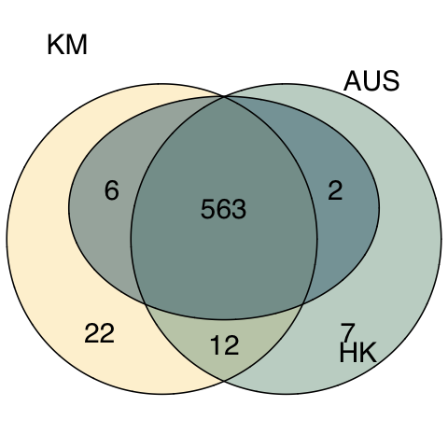
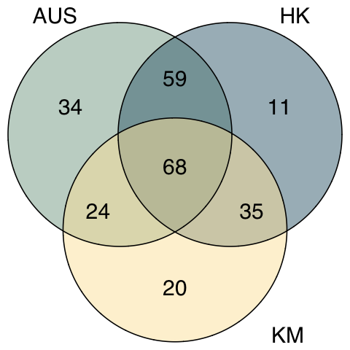
Venn Diagram for Pathways
Unfiltered
Filtered (p<=0.05)

Slide 17
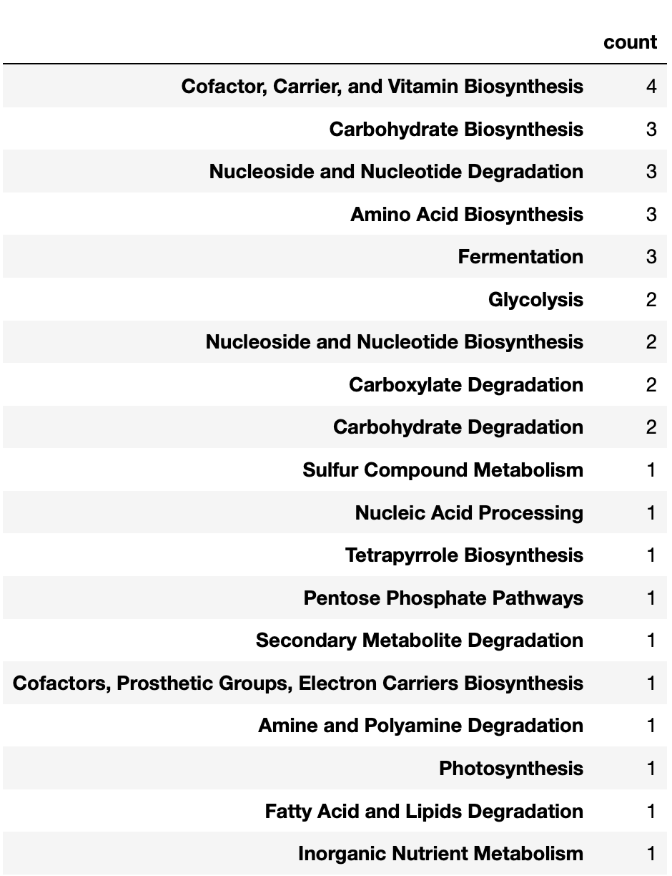
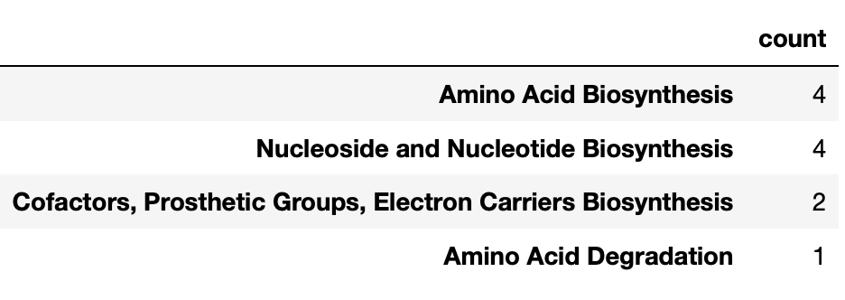
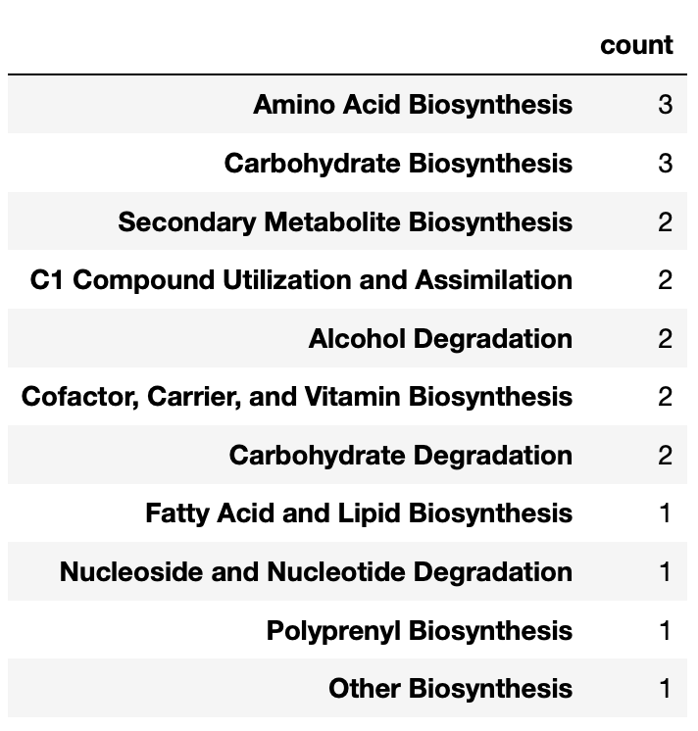
Functions from Unique Pathways in AUS, HK, and KM
Filtered (p<=0.05)
Notes:
Function 个数

Slide 18
CD-enriched and CD-depleted Pathways in AUS, HK, and KM
Most Frequent CD-enriched Functions:
Cofactor, Carrier, and Vitamin Biosynthesis
Fatty Acid and Lipid Biosynthesis
Amino Acid Biosynthesis
CD-enriched
CD-depleted
Most Frequent CD-depleted Functions:
Cofactor, Carrier, and Vitamin Biosynthesis
Cell Structure Biosynthesis
Amino Acid Biosynthesis
Coef

Slide 19
Bacterial Species contributing to CD-enriched and CD-depleted Pathways
CD-depleted
CD-enriched
Relative Abundance

Slide 20
Functions contributed by Faecalibacterium prausnitzii
 | Count
Amino Acid Biosynthesis | 14
Cofactor, Carrier, and Vitamin Biosynthesis | 11
Nucleoside and Nucleotide Biosynthesis | 10
Carbohydrate Biosynthesis | 8
Cell Structure Biosynthesis | 5
Fatty Acid and Lipid Biosynthesis | 5
Carbohydrate Degradation | 5
Nucleoside and Nucleotide Degradation | 4
Carboxylate Degradation | 3
Glycolysis | 2
Fermentation | 2
Aromatic Compound Biosynthesis | 2
Pentose Phosphate Pathways | 1
Amine and Polyamine Degradation | 1
Secondary Metabolite Degradation | 1
Nucleic Acid Processing | 1
Protein Modification | 1
Generation of Precursor Metabolites and Energy | 1
Aminoacyl-tRNA Charging | 1

Slide 21
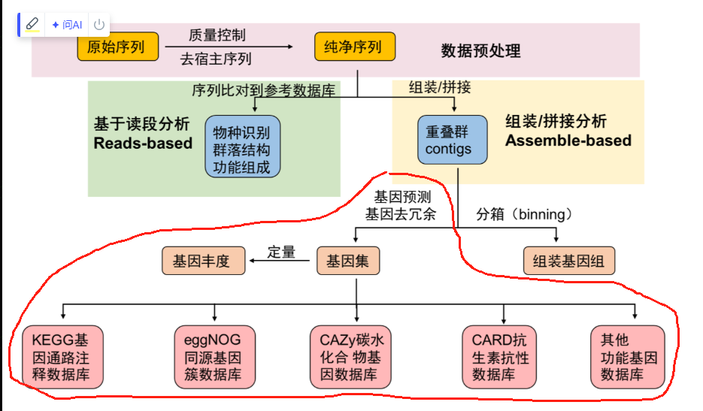
Microbial Gene Annotation Workflow
Assembly to Contigs
(MEGAHIT)
Gene Prediction
(Prodigal)
Gene Cluster
(MMseq2)
Gene Abundance
Non-redundant Gene Catalog
(1379 7256 genes)
Gene Database

Slide 22
Microbial Gene Analysis Workflow
Genome Assembly Data (Gene Count)
Venn Diagram
Venn Diagram
Data Filtering
Venn Diagram
Volcano Plots
DESeq2
Venn Diagram
Heatmap
CD-enriched and CD-depleted Genes

Slide 23
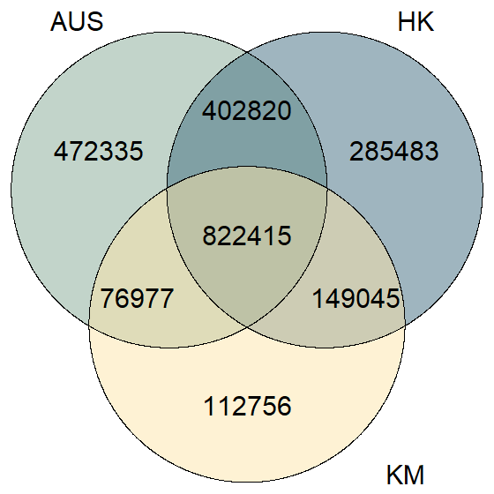
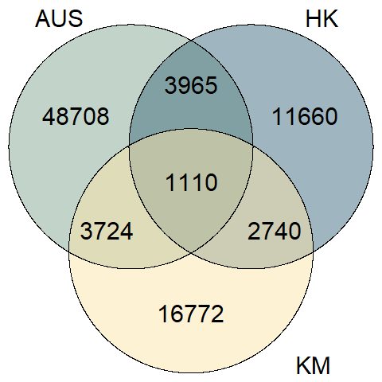
Venn Diagram for Microbial Genes
Unfiltered
Filtered (p<=0.05)
Notes:
left side: based on raw gene count; right side: based on DESeq2 output

Slide 24
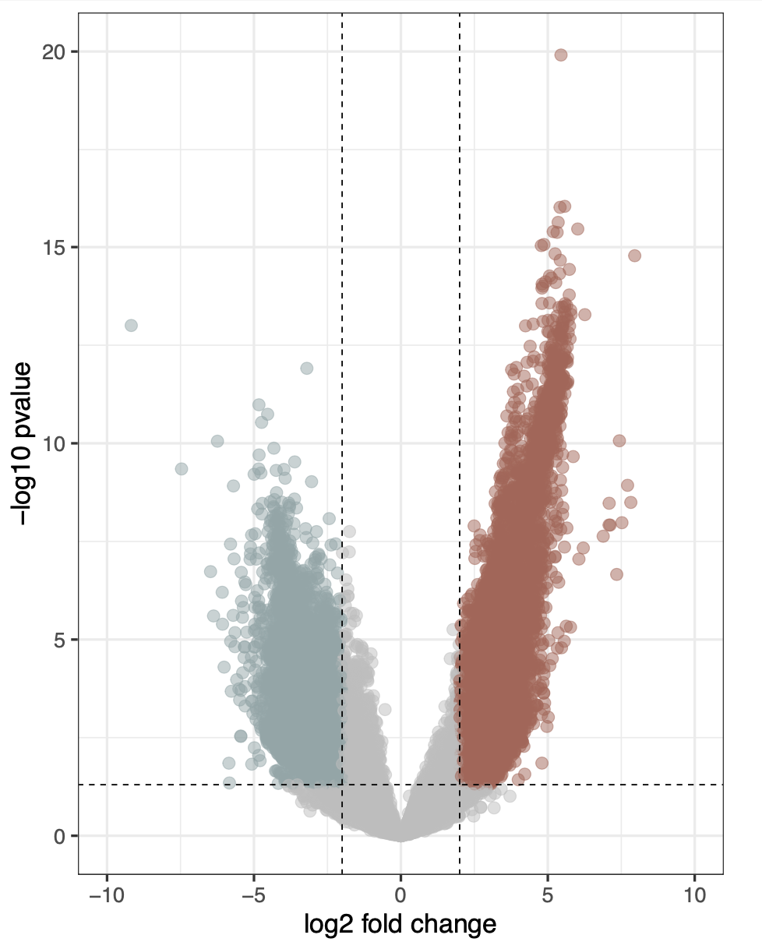
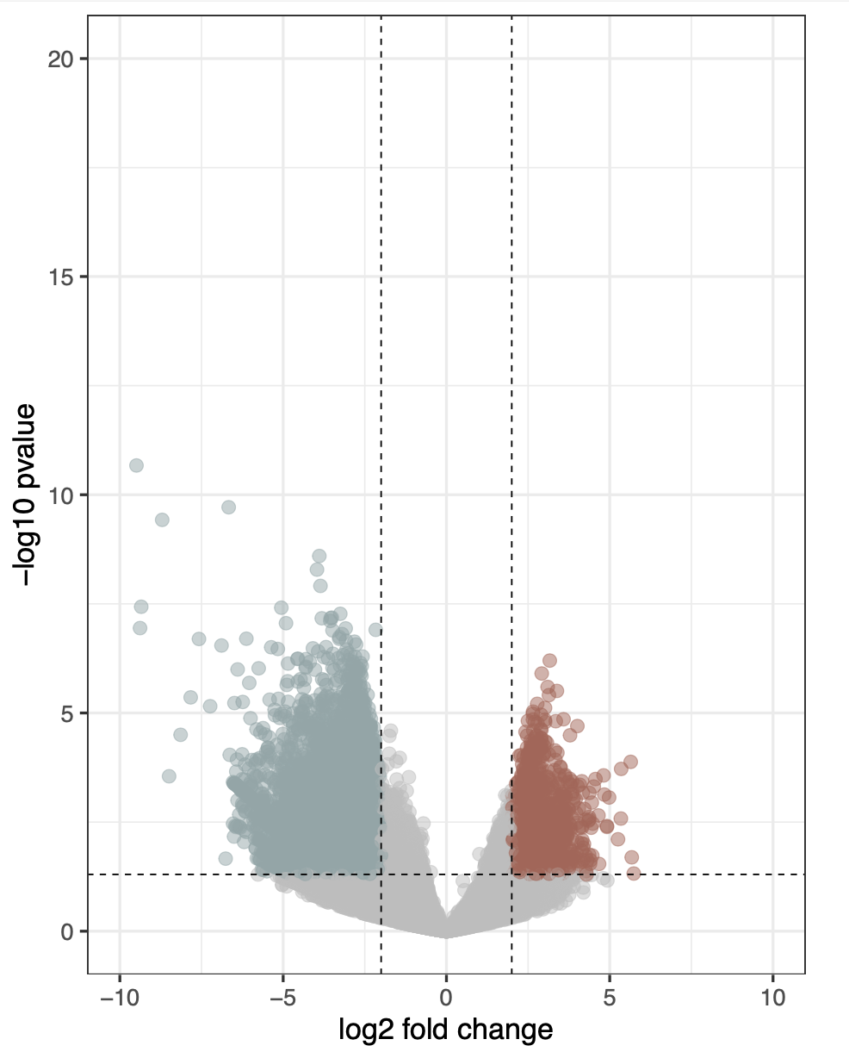
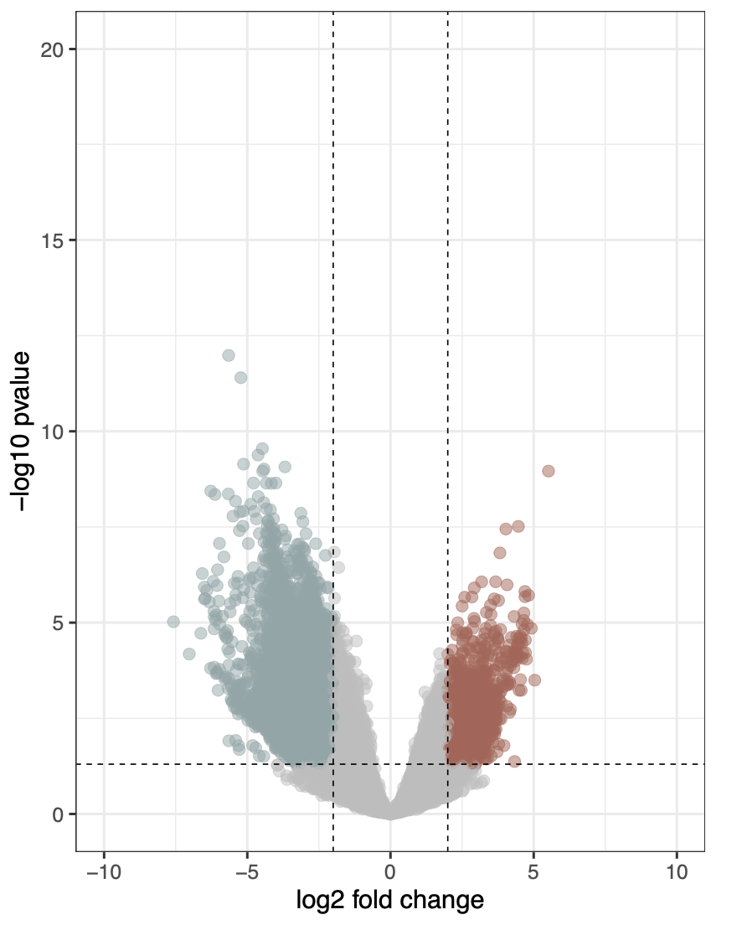
CD-enriched and CD-depleted Microbial Genes in AUS, HK, and KM
CD-depleted
CD-enriched
CD-depleted
CD-enriched
CD-depleted
CD-enriched
AUS
HK
KM
26160
8080
12655
1856
11591
2268
Cutoff for log2 FC is 2
Cutoff for p-value is 0.05
Cutoff for log2 FC is 2
Cutoff for p-value is 0.05
Cutoff for log2 FC is 2
Cutoff for p-value is 0.05

Slide 25
Microbial Gene Annotation Workflow
126
Virulence Factor Genes (VFGs)
1077
864
|log2 FC| > 2
Microbial genes consistently up- and down-regulated in CD patients cross AUS, HK, and KM
57
Antibiotic Resistance Genes (ARGs)
p<=0.05
Notes:
Venn Diagram: Based on DESeq output

Slide 26
CD-enriched and CD-depleted Microbial Genes in AUS, HK, and KM
CD-depleted
CD-enriched
CD-depleted
CD-enriched
CD-depleted
CD-enriched
AUS
HK
KM
smeS
acrB
26160
8080
12655
1856
11591
2268
kpsF
gspF
clbB
Erm(37)
wcbR
lpfC
cpxA
otr(A)
Cutoff for log2 FC is 2
Cutoff for p-value is 0.05
Cutoff for log2 FC is 2
Cutoff for p-value is 0.05
Cutoff for log2 FC is 2
Cutoff for p-value is 0.05

Slide 27
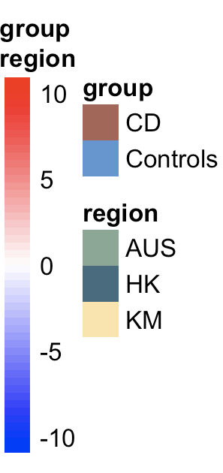
VFGs constantly up- and down-regulated in CD patients cross AUS, HK, and KM
CD-depleted VFGs
(n=48)
CD-enriched VFGs
(n=78)
Notes:
Scale

Slide 28
ARGs constantly up- and down- regulated in CD patients cross AUS, HK, and KM
Notes:
CD-enriched vs CD-depleted = 30:27
后缀

Slide 29
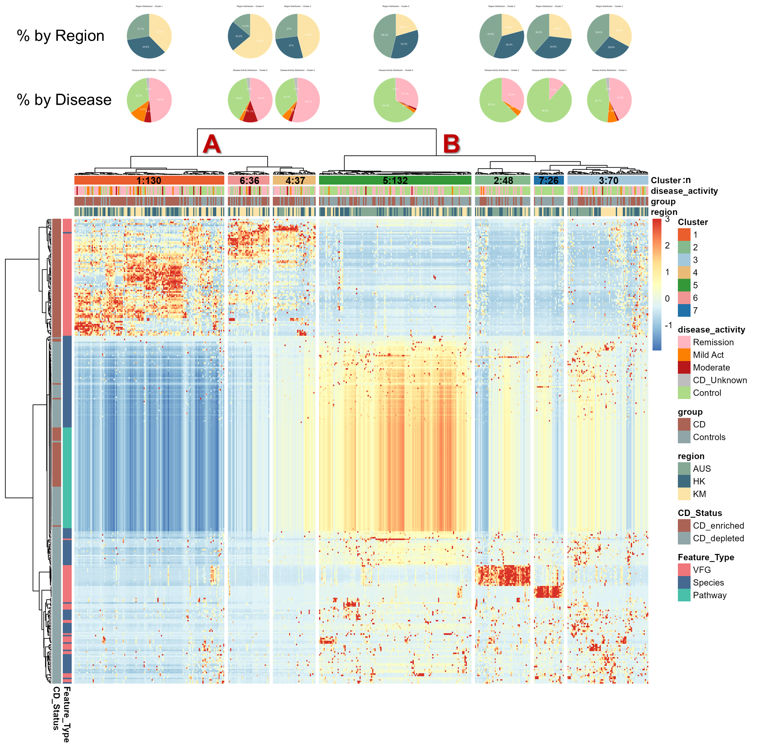
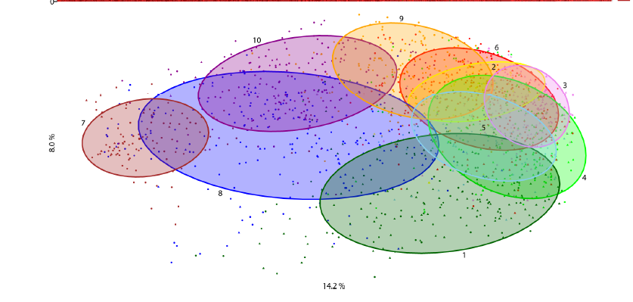
Notes:
remission= inactive，mild和moderate = active
more CD patients concentrated in cluster A, while more healthy individuals made of cluster B
The heatmap showed us how the multi-omic signatures of CD patients and healthy individuals look like
We made association networks based on the two big clusters derived from this plot: cluster A and cluster B
To better describe the multi-omic signature of all seven clusters, we will make more detailed analysis in the next step

Slide 30
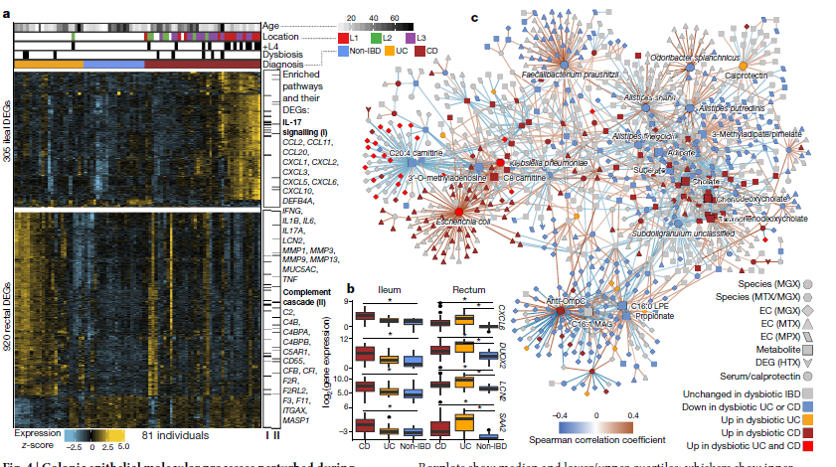
Notes:
Multi-omics of the gut microbial ecosystem in inflammatory bowel diseases

Slide 31
Maaslin2
Active vs inactive (HK)
Active vs inactive (AUS)
Any overlap?
Active vs inactive (KM)
Active vs inactive (ALL)

Slide 32
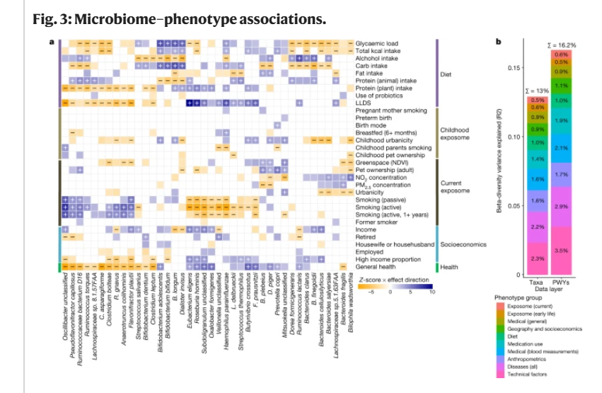
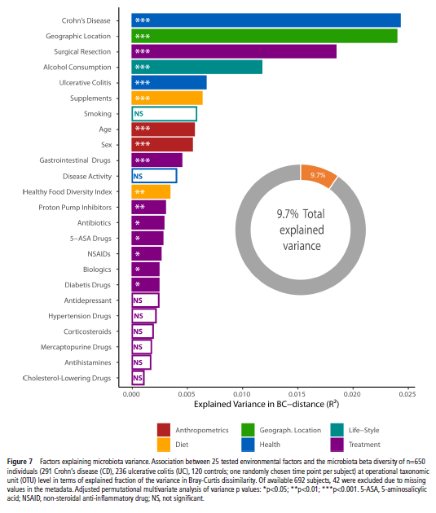
Notes:
Ranking microbiome variance in inflammatory bowel disease: a large longitudinal intercontinental study
Environmental factors shaping the gut microbiome in a Dutch population

Slide 33
Notes:
Environmental factors shaping the gut microbiome in a Dutch population

